Slide 1
My Daily Life Cut (하루내컷)
Working Progress and
Experiening hardness
Avengers
1. David, Jeon
2. Ji Won, Hur
3. Ji Yun, Park
4. Young Hoon, Lee

Slide 2
Development Progress
Backend (Django REST api server)
Design Architecture
Database Modeling (with ERD)
Developed Models , Views, Serializers, Urls and settings
Deployed to AWS cloud
Developing missing parts (diary component, etc)
Frontend (Android Native App)
Work Flow Architecture
Main, Login, Camera, Archive, Introduce page developed
Connected to Microsoft Azure Face API
Connected to Cloudinary for saving user image
Connecting Backend

Slide 3
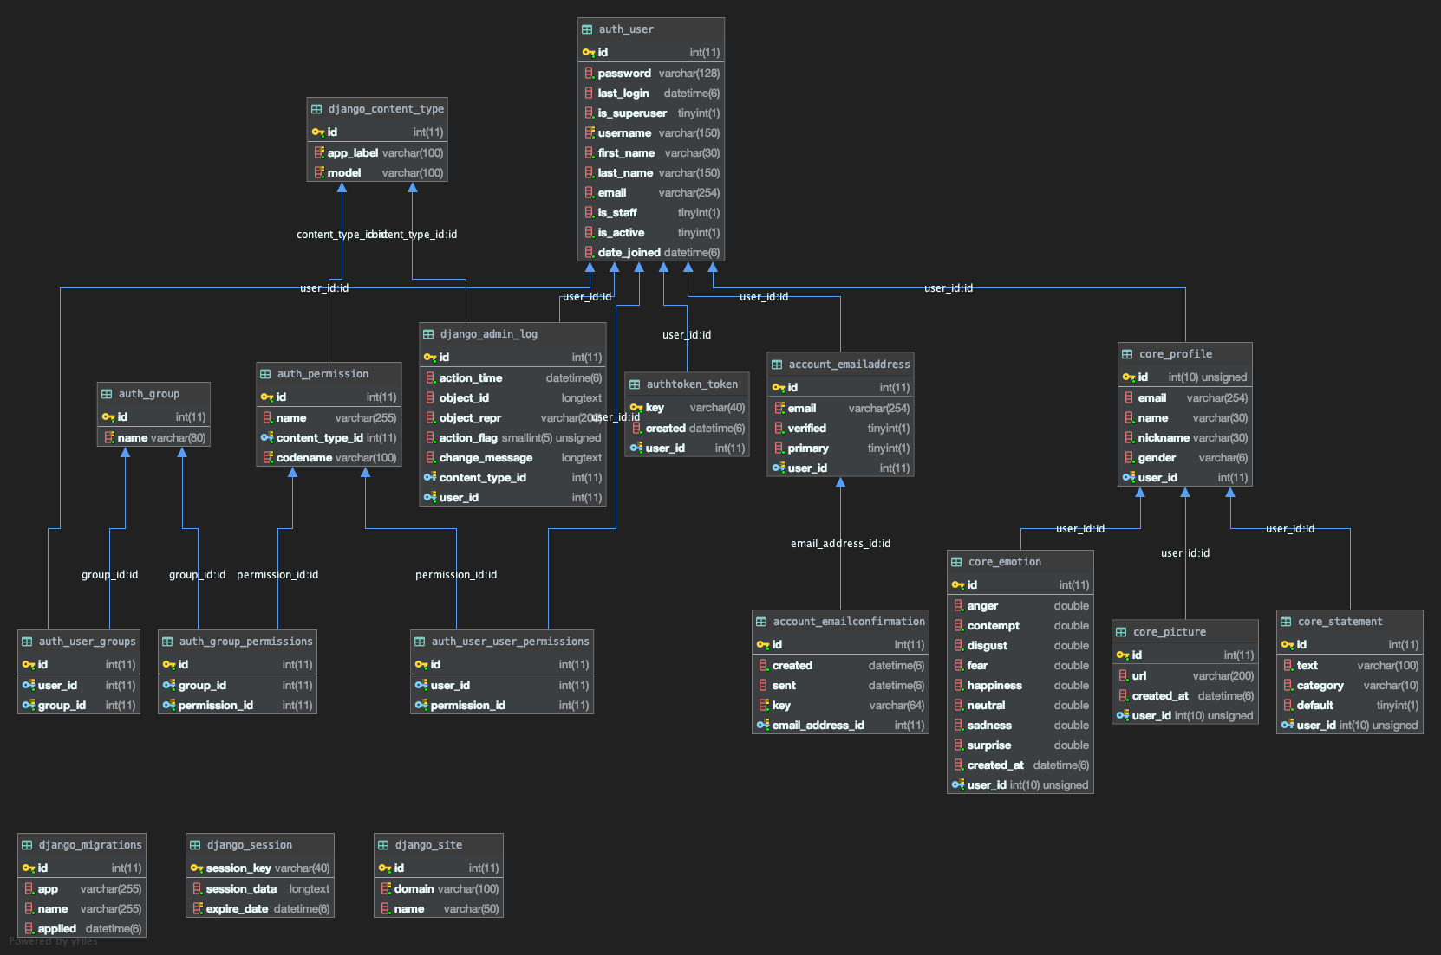
Development Progress
Entity Relation Diagram

Slide 4
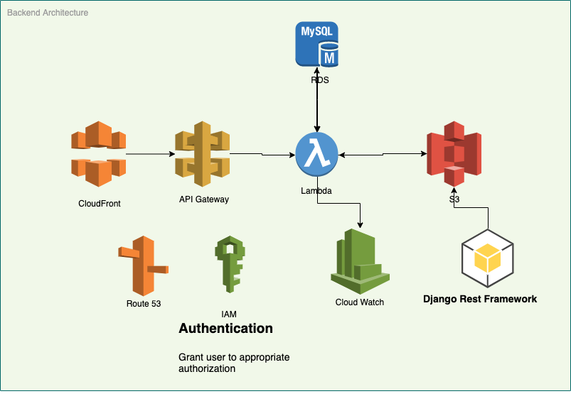
Development Progress
Backend Architecture

Slide 5
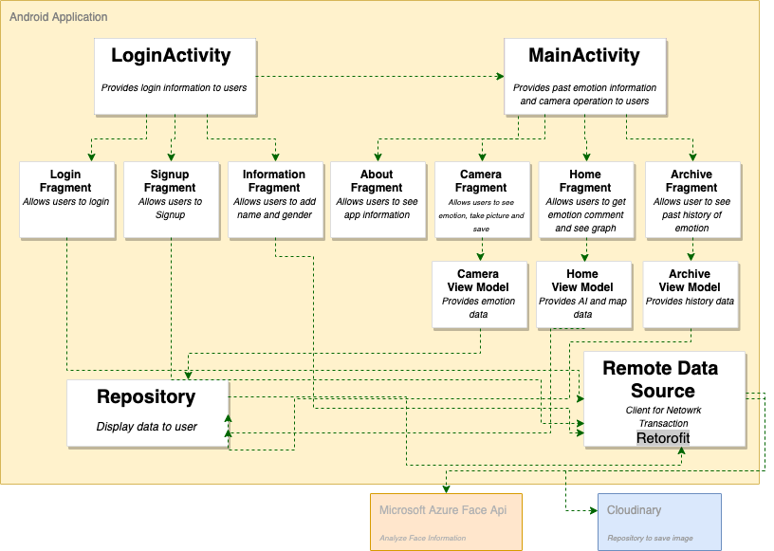
Development Progress
Frontend Architecture

Slide 6
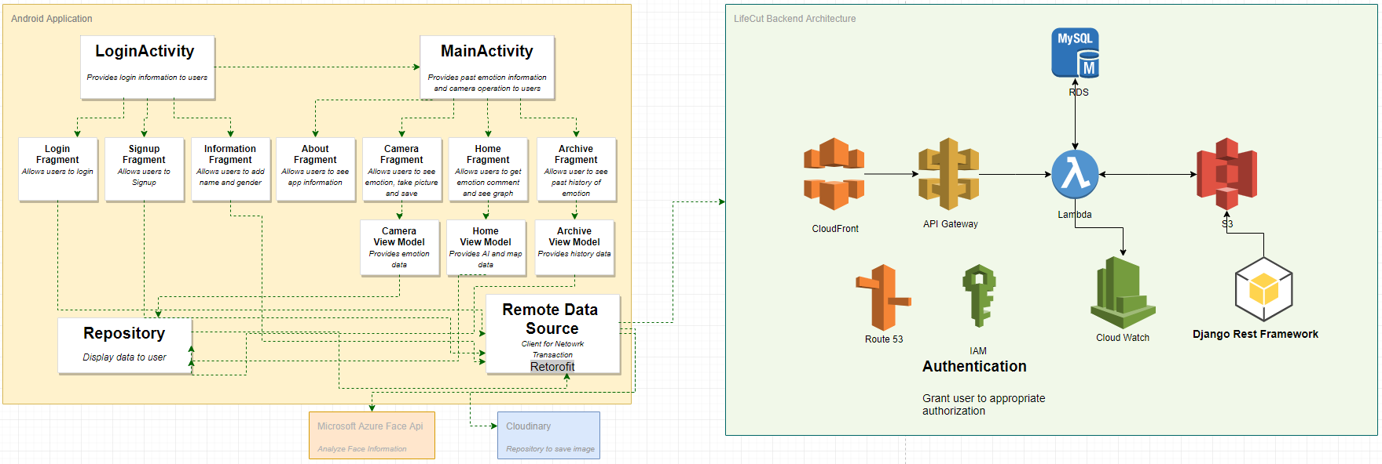
Development Progress
Overall Architecture

Slide 7
Design Progress
Desgined Service Flow Chart
Composed Wireframe

Slide 8
Design Progress
Service Flow Chart

Slide 9
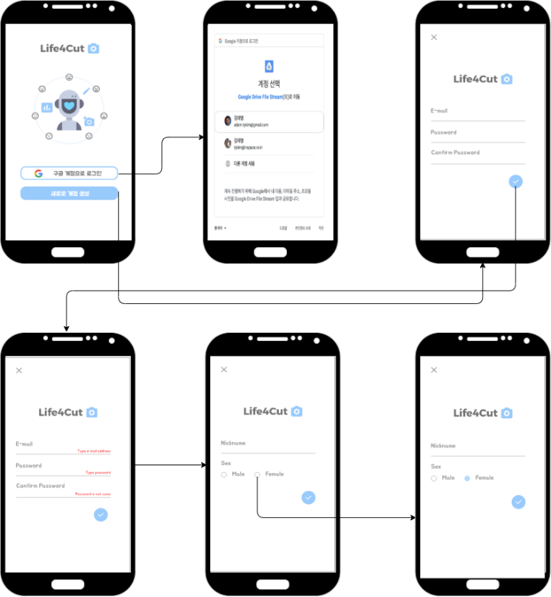
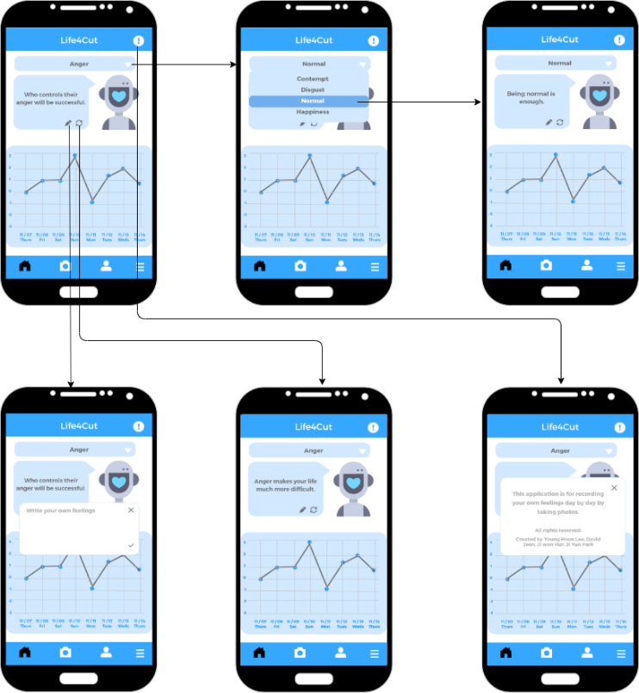
Design Progress
Composed Wireframe
Sign in, Sign up Page
Home Page

Slide 10
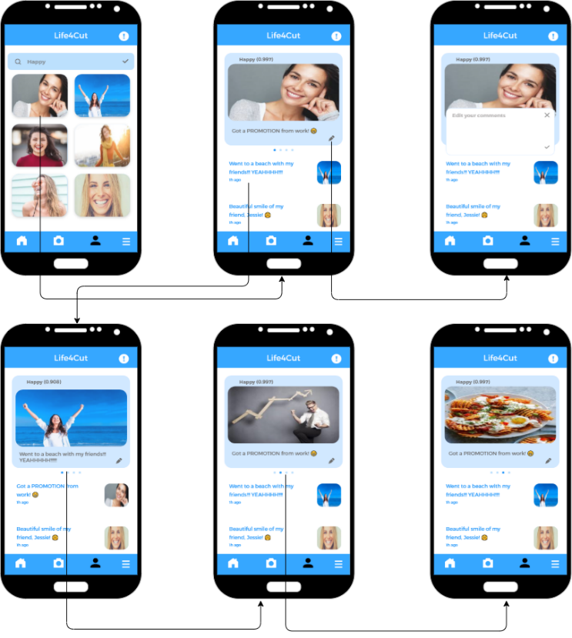
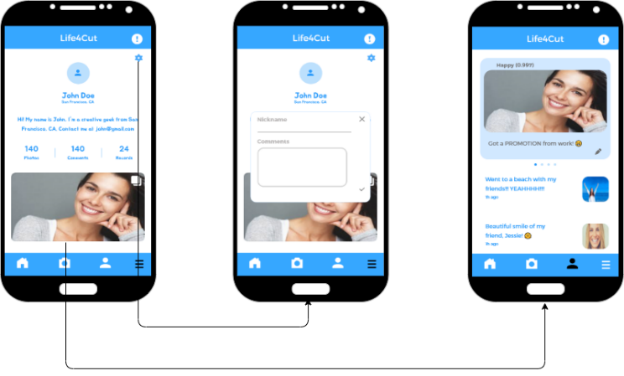
Design Progress
Composed Wireframe
Archive Page
Setting Page

Slide 11
Experiencing hardness (but return grow-up)
First experience of “team” project
It requires communication more than self-proejct
It reuiqres co-work skills
Learning curve to new tools, framework, langague and thid party, etc.
Chaning plans is necessary in specific situation. It makes another developement and design.
Lack of time brings tight development and design timeline
We are under DDD (Deadline Driven Development)
But we are Avengers.
We believe these hardships take avengers to higher.

